Slide 1
Directions for Races
Split class into 3 teams.
Each time a team answers a question correctly press on the corresponding color explosion.
You can reuse game over and over using different review questions.

Slide 2

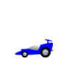


1
2
3
Red Hot Racers

